Slide 1

GROUP 22
Lovely Digra IIT2017090
Abhishek Vishwakarma IIT2017091
Anuj Raj IIT2017092

Slide 2
Problem Statement
Our required aim is to design and analyse an aglorithm for complex number multiplication without using multiplication, division or modulo operator and we need to plot Accuracy Vs Number of decimal points graph.

Slide 3
Introduction
With the advancement of technology certain basic computations is taken for granted by the programmers. One such example is arithmetic multiplication of two nos. Suppose the system hardware does not have architecture required for multiplication using ’∗’ operator.
Now the question arises how to perform single digit multiplication without using an asterisk?
For this, A 1-D look-up table is created to get the result by
the multiplication of two single digit numbers.

Slide 4
Algorithm
Simple(Naive) Approach :
> To calculate product of any two complex number of the form(a+ib and
c+id), separate real and img part of the result as(ac-bd + i(ad+bc)) and perform multiplication of simply two floating point no’s .
> To find product of two floating no’s use lookUp table.
> Firstly, calculate the no. of digits lying after decimal point and then convert the floating no’s into a string .
> Now , use string operations for multiplication. Take each digit of multiplier and multiply it with each digit of multiplicand .

Slide 5
> Product of any two single digit no. for example multiplication of a and b can be found in the look-up table by accessing the location “9*(a-1)+(b-1)” in lookup table by using repeated addition.
> Store the intermediate result of product of num1 with each digit of num2 in a 2-D Matrix, like the way a primary school students does .
> Finally add the intermediate results in column fashion to
get the final result.
> And at last represent the found result in the form of complex no. i.e (a + ib) .

Slide 6
Algorithm
Optimisation :
> Instead of storing intermediate values in 2-D matrix concatenate the result into a string and parse it to get the intermediate result.
> Now addition becomes very simple . Just add it to the variable storing the final result.
> Repeat the process for every digit of num2 to get the final result.
> And at last represent the found result in the form of complex no. i.e
(a + ib).

Slide 7
Pseudo Code
procedure mul(inta)
for all i = 1 to a do
//a times repeated addn of c where is 9
return c
procedure lookup(inta, intb)
return look-Up[mul(a−1)+(b−1)]
a←Real part of 1st num
b←Img part of 1st num
c←Real part of 2nd num
d←Img part of 2nd num
num1String←parsed a to string
num2String←parsed c to string
reverse(num1Str)
reverse(num2Str)

Slide 8
for all i = 1 to no of digits in num1 do
carry←0
for all j = 1 to no of digits in num2 do
product←lookup(num1Str[i], num2Str[j])
product←product+carry
result←unit_place_of_product
carry←tens_place_of_product
intermediate_result←concatenate(result)
procedure reverse(intermediateresult)
finalResult←finalResult+intermediateRes
print(finalResult)

Slide 9
Experimental Analysis
For the experimental analysis of this algorithm, we will take same values of real and imaginary part for both complex numbers for easy calculations and find product of real-real,real-imaginary or imaginary-imaginary parts.
And for every single digit pair of the multiplicant and the multiplier we need to access product from the look-Up table at max 9 iterations in the repeated addition loop of mul(9) for function and 0 iterations for mul(0).

Slide 10
The Best Case
As time complexity depends on the number of digits of multiplier, number of digits in the multiplicant and value of the single
digit of each pair of the two integers.So the Best Case is when each single digit pair contains atleast one 0 with growth rate
Ω(1 ∗ d ∗ d) where, d is the total digits in the given integer.

Slide 11
The Worst Case
Worst Case arises if each single digit pair of multiplicant and multiplier integers is 9 as in this case we need to access product from the look-Up table at max 9 iterations in the repeated addition loop of mul(9) for the function.
The growth rate for the worst case will be bounded by
O(9 ∗ d ∗ d)
Where, d is the total digits in the given integer.

Slide 12
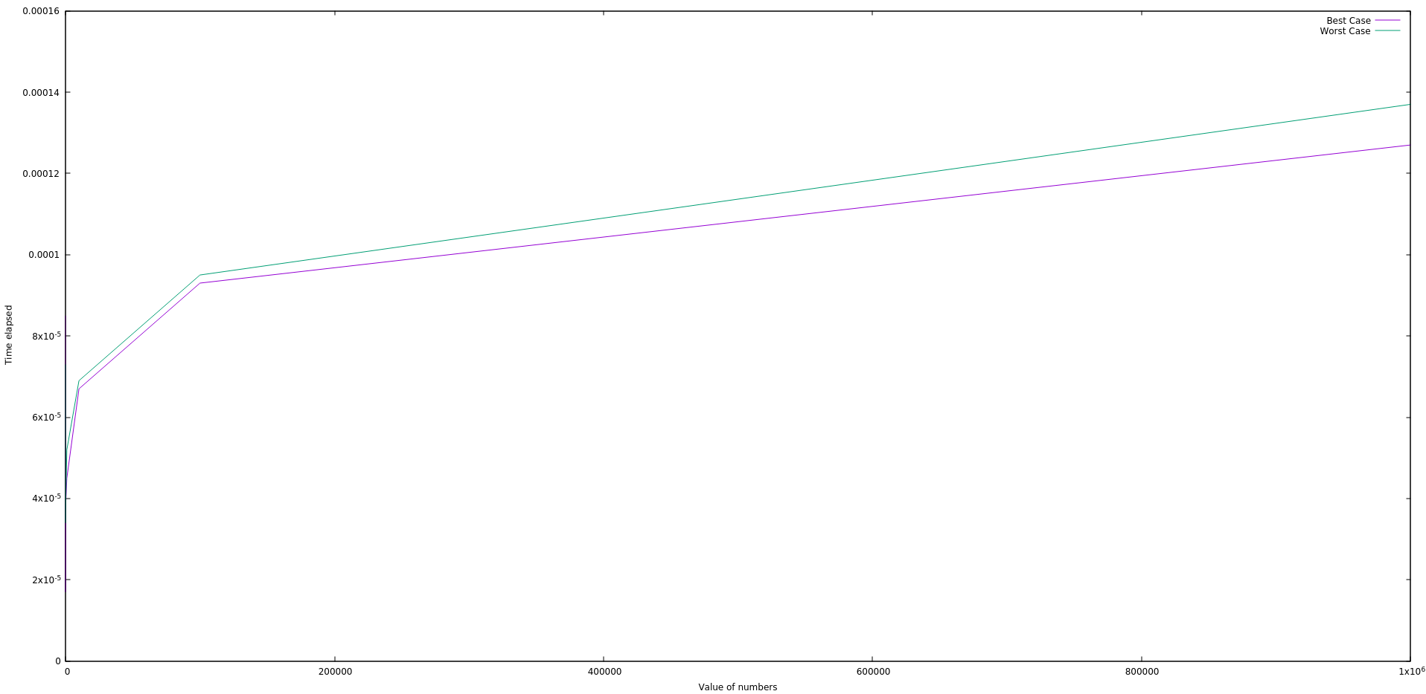
The Graph
Value of Number vs Time elapsed

Slide 13
Numerical Analysis

Slide 14
Reason for Numerical Analysis :
In a computer, real numbers are represented with finite precision. This finite-precision representation leads to unavoidable errors, especially when floating-point numbers, which are digital approximations to real numbers, are involved.
why floating-point numbers are inherently inaccurate?
Floating-point numbers are represented by strings of a limited number of bits, but represent numbers much larger or smaller than that number of digits can be made to express.
In other words, floating-point values are finite-precision approximations of infinitely precise numbers.
Basically Two kind errors is observed :
RoundOff Errors
Truncation Errors

Slide 15
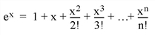
RoundOff Errors
the machine accuracy roughly corresponds to a change of the least significant bit of the floating-point mantissa—precisely what can happen if a number with more significant digits than fit in the floating-point mantissa is rounded to fit the space available
Truncation Errors
Similar to RoundOff Errors. but here not the system hardware but is algorithm itself is the cause.
For example, consider the process of calculating
Obviously, the answer becomes more accurate as n approaches infinity. When performing the actual computation, however, a cutoff value must be specified for n. Increasing n reduces truncation error at the expense of computational effort.

Slide 16
How we removed this ?
Again using strings for calculation when can increase the Finite Representation Problem.
Since string size can be large enough to accomodate the result. Thus the whole Algorithm is based on string manipulation.
Functions like add() decimalPos() used in the algorithm helps in adding to string as numbers and finding the decimal position of the String representation of the floating point numbers.
Thus the algorithm gives Hundred percent accurate results.
This accuracy is not even achieved with the double data type used for double precision for calculations..
Thus the algorithm can used as a standard to calculate the errors in float and double representation.

Slide 17
Accuracy Table
We formatted a table to show the accuracy for float and Double Data representation.

Slide 18
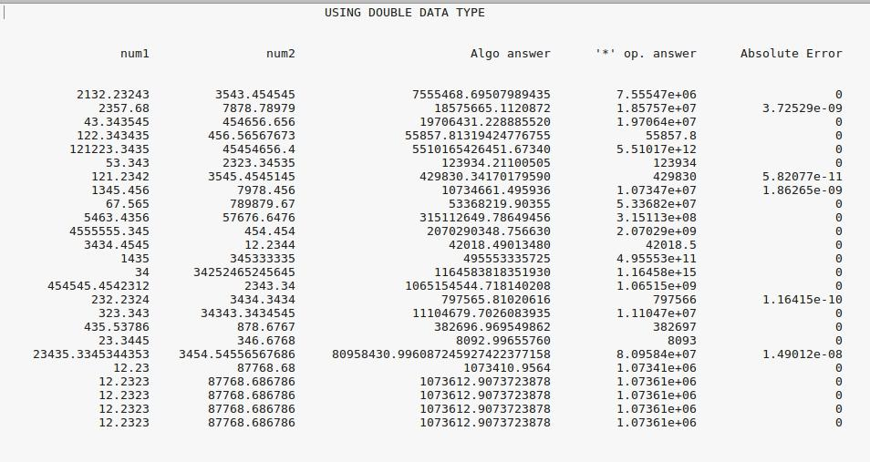

Slide 19
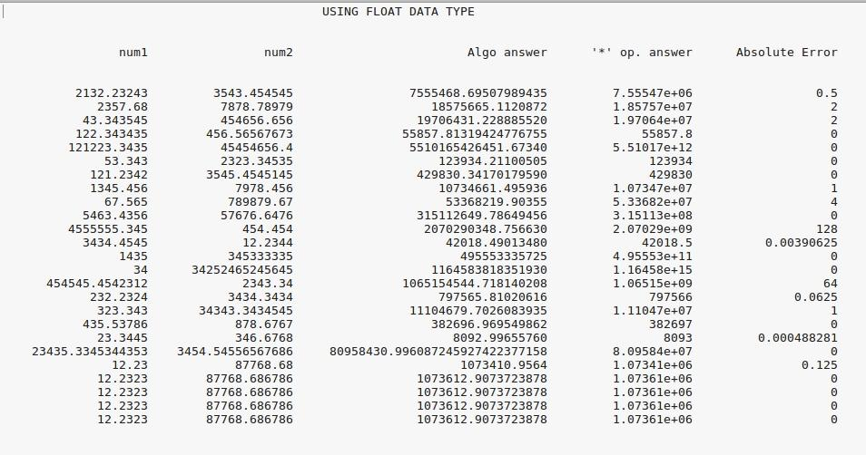

Slide 20
Accuracy vs product Graph
1 floating point represenation
2 double precision representation

Slide 21
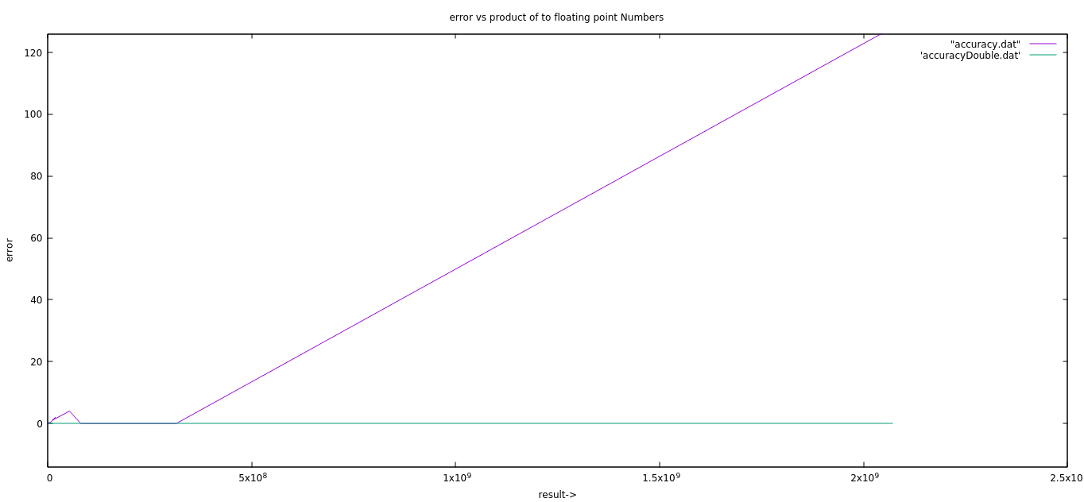

Slide 22
Conclusion
The Algorithm is correct , accurate and optimal under the constraints defined in the Problem Statement.

Slide 23
Thank You!

